Slide 1



Collective control of modular soft robots via embodied Spiking Neural Cellular Automata
From Cells to Societies - ICLR 2022 Workshop
Giorgia Nadizar, Eric Medvet, Stefano Nichele, Sidney Pontes-Filho

Slide 2
Motivation
Modular robots are composed of many modules
Modules as intelligent sub-agents, each acts independently
Behavior deriving from the collectivity, need for collective control

Slide 3
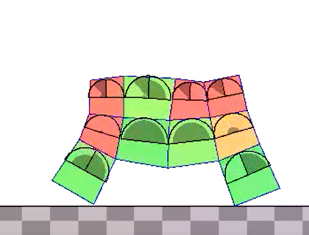
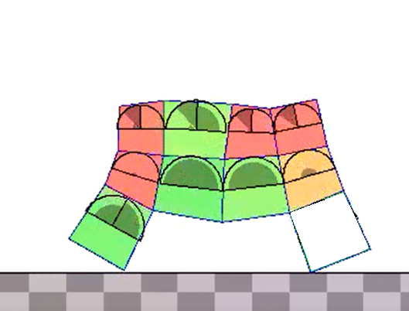

Voxel-based Soft Robots (VSRs)
Modular (each voxel is a module)
Soft (move via voxel contraction and expansion)
«Intelligent» modules
Sense
Act
Communicate with neighbors
Notes:
Convenient to have intelligent modules instead of a centralized controller -> exploit modularity+reconfigurability and eases implementation (less wiring)

Slide 4
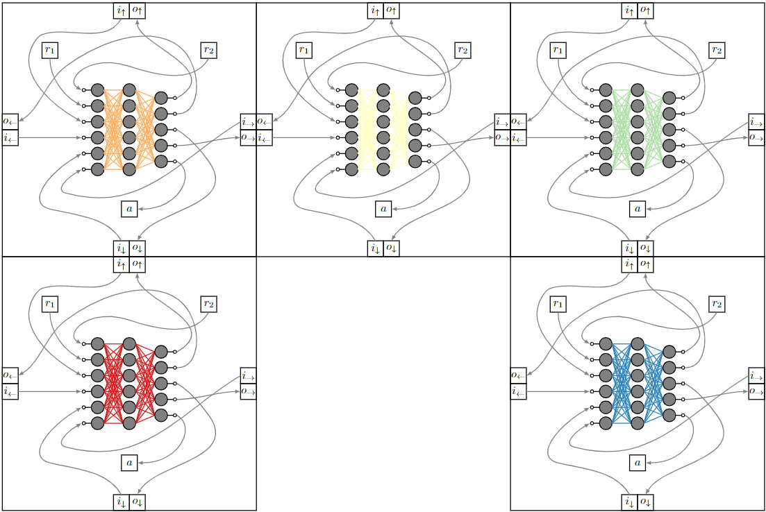
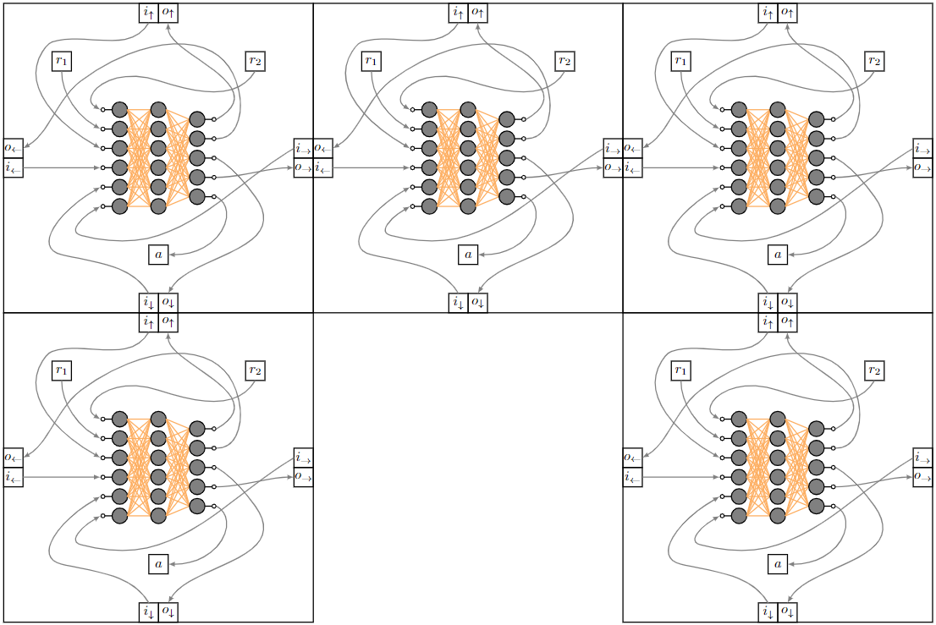
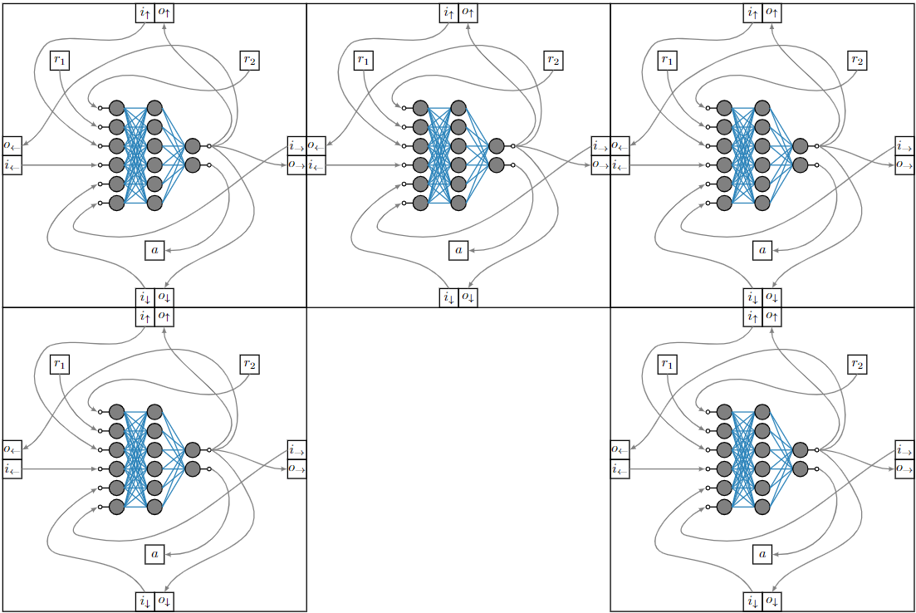
Embodied Neural Cellular Automata
Non-uniform
Directional
Uniform
Directional
Uniform
Non-directional
Notes:
Endow intelligence by NN in each voxel -> grid~NCA + embodiment -> 2 already in the lit -> new one Convenient to have them all alike (for implementation) and avoid directionality for reconfigurability matters (turn them around namely)

Slide 5
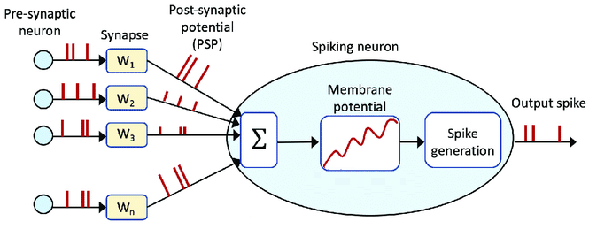



Spiking Neural Networks (SNN)
Model membrane potential of neurons
Allow plasticity mechanisms and learning
Require conversion due to different encoding
Notes:
More bio inspo -> bring advantages of that Conversion -> frequency -> only for sensing/actuation, not communication

Slide 6



Experimental evaluation
Non-uniform Directional MLP
Uniform Directional MLP
Uniform Non-directional SNN
Task of locomotion
(on flat terrain)
Generalization on
unseen terrains

Slide 7
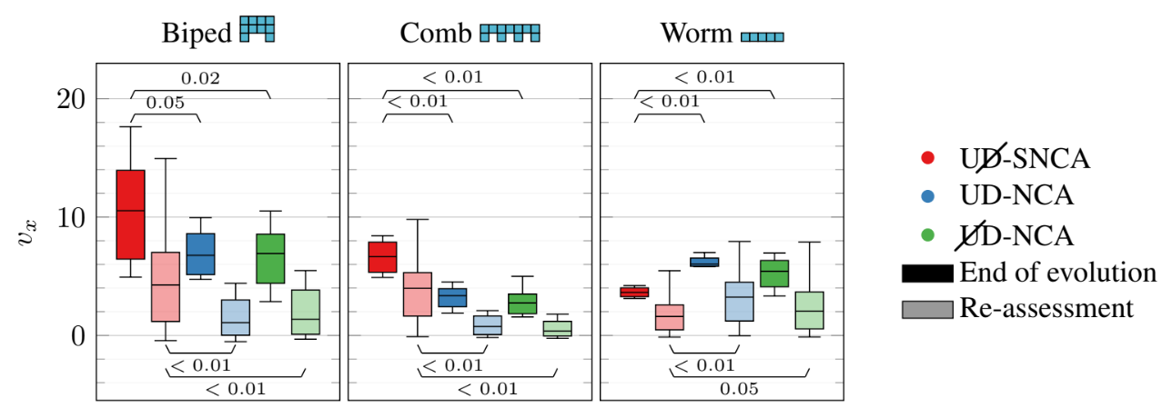

Results
Notes:
Subset of results -> velocities dist. -> end of evo and re assess -> for biped
Red ours -> improvement
Significant generalization
Behavior more natural, less high freq -> no RG -> physical impl.

Slide 8
Thanks!
giorgia.nadizar@phd.units.it
giorgia-nadizar.github.io

